Slide 1
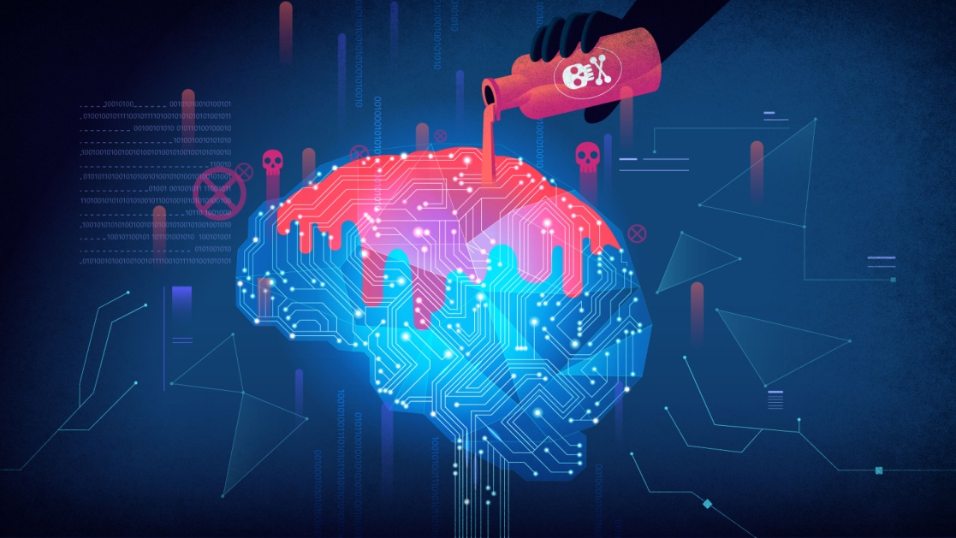
Data Poisoning
What It Is:
Data poisoning is when attackers manipulate the training data of a machine learning model to influence or corrupt its future behavior. Since AI learns patterns from data, poisoned inputs can introduce backdoors, cause misclassification, or degrade performance in subtle ways.

Slide 2

Example
Chatbot Behavior Manipulation
AI chatbots trained on online data can pick up harmful or biased language if bad actors flood training forums or public datasets with certain ideologies.
Example: Microsoft’s chatbot Tay (2016) was poisoned by users tweeting offensive content, causing the bot to repeat racist and hateful language within hours.

Slide 3

Lack of Explainability (Black Box Models)
What It Is:
Many modern AI systems, especially deep learning models like GPT or image classifiers, are black boxes: they give outputs, but don’t explain why. This makes it hard to trust or debug their decisions, especially in high-stakes areas like healthcare or criminal justice.

Slide 4

Example
Medical Diagnosis
An AI model predicts cancer from MRI scans with high accuracy.
But doctors can’t tell what features the AI is relying on — maybe it's focusing on irrelevant details, like a watermark or scanner brand.
Without explainability, even correct predictions can't be trusted or verified.

